Slide 1
Disparities in Breast and Cervical Cancer Outcomes
Bianca McAlister
Epidemiology Affinity Group
Phase III Master’s Research
April 24th 2026
Morehouse School of Medicine
Master of Public Health Program

Slide 2
Table of Contents
Introduction
Background
Methods
Statistical Analysis
Results
Discussion
Recommendations
Website
Questions
References

Slide 3
Introduction
Breast and cervical cancers remain two of the top four most common cancers affecting women globally. Despite major advances in prevention, screening, and treatment, persistent inequities continue to shape outcomes.
Cervical Cancer
Breast Cancer
4,000 deaths/year
Considered one of the most preventable cancers
Develops slowly
Stage I is the most treatable.
HPV is the primary cause
Vaccination and screening remain underutilized
#1 diagnosed cancer in women (US)
2nd leading cause of cancer death
30% of total annual cancer incidence
Risk factors
Age, genetics, obesity, smoking, nutrition, and alcohol consumption
5-10% are hereditary (BRCA1/2).
Cervical Cancer Incidence
* United States: 14,000
* Globally: 660,000
Breast Cancer Incidence
* United States: 287,000
* Globally: 2.3 Million
Notes:
Shorten into key words

Slide 4
Background
Prevention tools exist — yet disparities persist.
Cervical Cancer Prevention
HPV vaccination, routine Pap screening and HPV testing, and safe sex practices are highly effective yet inequitably accessed.
Breast Cancer Prevention
Mammography (starting age 40) and risk reduction strategies exist, but access and adherence vary significantly by race, income, and insurance.
The Equity Gap
Socioeconomic, racial/ethnic, and geographic factors shape who benefits from these tools. This research examines national BRFSS data to quantify these disparities.

Slide 5
Methods
Data Source: 2024 Behavioral Risk Factor Surveillance System (BRFSS)
• Cross‑sectional analytic study
• Analysis conducted using RStudio (2025.09.2+418)
• Logistic regression models used to evaluate screening adherence
Analytic Sample & Variables
Breast Cancer Screening: Women aged 50–74 years Cervical Cancer Screening: Women aged 21–65 years Outcomes: Up-to-date mammography (within 2 yrs); Up-to-date Pap test (within 3 yrs) Key Predictors: Routine checkup, personal doctor, insurance status, cost barriers, race/ethnicity

Slide 6
Methods – Research Question
Research Question:
Among age-eligible women in BRFSS 2024, what healthcare access, demographic and socioeconomic factors are associated with being up to date on breast and cervical cancer screening?
Key Indicators:
Recent Routine Checkup
Having a Personal Doctor
Insured vs Uninsured (With Personal Provider)
Cost Related Barriers
Race/ Ethnicity
Notes:
Key subquestion. -- this wis w
Don’t inherently call them subsquestions
Key indicatior

Slide 7
Statistical Analysis
All analyses accounted for the BRFSS complex survey design using primary sampling units (PSU), state-level stratification, and final sampling weights.
01
Survey-Weighted GLM
02
Interpretation of Results
Generalized linear models with binomial distribution accounted for the complex BRFSS design (PSU, strata, weights).
Model outputs log-odds (β coefficients) → converted to odds ratios (ORs) for interpretation
03
Why Survey Weights Matter
04
Covariates Adjusted
BRFSS does not use simple random sampling. Weights adjust for unequal selection probability, non-response bias, and demographic alignment with known population totals.
Age, race/ethnicity, insurance status, having a personal doctor, recent checkup, and cost-related barriers to care.
Notes:
You cannot generalize it based on →
Here are some basic points about survey weights in the analysis section:
BRFSS does not use a simple random sample, so not everyone has the same chance of being selected. Survey weights adjust for this unequal sampling.
Some groups are less likely to respond to surveys, which can bias results. Weights help correct for this nonresponse so the data better reflect the full population.
The data are also adjusted to match known population characteristics, like age, sex, and race. This ensures the sample aligns with real-world demographics.
Without weights, the analysis would only represent the people who answered the survey—not the broader population.
Using survey weights allows us to produce more accurate and generalizable estimates, like prevalence rates of health behaviors or conditions.
When combined with the survey design (like strata and clusters), weights also help produce correct confidence intervals and standard errors.
Script:
All analyses accounted for the complex BRFSS survey design, including weights, stratification, and clustering
This ensures that the findings are representative of the U.S. population and statistically valid
01 – Survey-Weighted GLM
I used survey-weighted generalized linear models to analyze the data.
This helps produce unbiased estimates that reflect the broader population.
Because BRFSS is not a simple random sample, this approach allows us to correctly incorporate weights, strata, and clusters.
02 – Quasibinomial Distribution
Since my outcomes are binary—whether someone is up to date on screening—I used a binomial model.
I applied a quasibinomial distribution to account for overdispersion, which improves the accuracy of standard errors.
03 – Why Survey Weights Matter
BRFSS uses unequal sampling, so not everyone has the same chance of being selected.
Weights adjust for this, as well as nonresponse bias and demographic differences.
Without weights, results would only reflect survey respondents—not the general population.
04 – Covariates Adjusted
The models adjusted for key factors including age, race and ethnicity, insurance status, having a personal doctor, recent checkups, and cost-related barriers.
This allows us to isolate the independent effect of each factor on screening adherence.

Slide 8
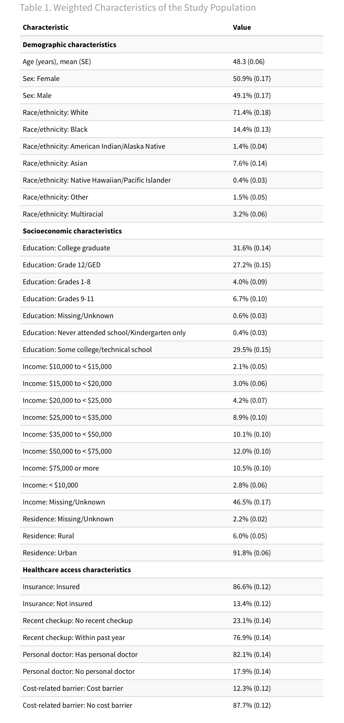
Results
Mammography (β; OR)
Cervical Screening (β; OR)
Recent Routine Checkup
β = 1.47; OR = 4.34
β = 0.78; OR = 2.19
Personal Healthcare Provider
β = 0.86; OR = 2.37
β = 0.75; OR = 2.12
Insured w/ Personal Provider
OR ≈ 2.26
OR ≈ 1.99
Uninsured w/ Personal Provider
OR ≈ 1.56
OR ≈ 1.53
Interpretation:
Women with a recent routine checkup had over 4× the odds of being up-to-date on mammography. Both recent visits and continuity of care independently predicted adherence. The protective effect of having a personal provider was stronger among insured women.
Notes:
**Insert notes related to the Methodology section here. Delete if not needed.**

Slide 9
Discussion
Routine Checkups Are Critical Access Points
Women with a recent routine visit had over 4× the odds of being up-to-date on mammography. Routine visits serve as the primary gateway for cancer screening referrals.
Continuity of Care Independently Matters
Having a personal healthcare provider was associated with higher screening odds even after adjusting for recent visits, reinforcing the role of ongoing patient-provider relationships.
Financial Barriers Persist Beyond Insurance
Cost-related barriers reduced adherence independent of insurance status, suggesting that coverage alone does not eliminate financial obstacles to preventive care.
Structural Factors Drive Persistent Disparities
Racial/ethnic disparities persisted after adjustment, indicating that access-related factors are important but insufficient explanations — structural inequities require targeted intervention.

Slide 10
Recommendations
Research
Longitudinal studies to establish causality between access factors and screening adherence.
Incorporate HPV awareness measures in future BRFSS modules.
Use mixed-methods research to further explore cultural and structural barriers by race/ethnicity.
Practice
Clinicians should use every patient encounter as an opportunity to promote cancer screening.
Strengthen patient-provider continuity to leverage the demonstrated protective effect.
Train providers on culturally responsive communication to reduce equity gaps.
Policy
Expand Medicaid and subsidized coverage to reduce cost barriers to preventive care.
Fund community health worker programs targeting under screened racial/ethnic groups.
Mandate that BRFSS and similar surveys include HPV awareness and knowledge items.
Notes:
**Insert notes related to the Purpose section here. Delete if not needed.**

Slide 11

QR CODE
To extend the impact of this work, I developed a website that translates my research into clear, digestible information for the public and communities that my research may affect.

Slide 12
QUESTIONS

Slide 13
References
Admoun, C., & Mayrovitz, H. N. (2022). The Etiology of Breast Cancer. In Breast Cancer. Exon.
Amboree, T. L., Damgacioglu, H., Chiao, E. Y., Schmeler, K. M., Sonawane, K., Deshmukh, A. A., & Montealegre, J. R. (2025). Rural-Urban Disparities in Cervical Cancer Incidence and Mortality Among US Women. JAMA network open, 3;8(3):e2462634.
American Cancer Society. (2026). Cancer Facts for Women. Retrieved from https://www.cancer.org/cancer/risk-prevention/understanding-cancer-risk/cancer-facts/cancer-facts-for-women.html
Cancer Stat Facts: Cervical Cancer . (2025). Retrieved from National Cancer Institute : https://seer.cancer.gov/statfacts/html/cervix.html
CDC. (2024, August 28). What Causes Hereditary Breast and Ovarian Cancers. Retrieved from US Centers for Disease Control and Prevention: https://www.cdc.gov/breast-ovarian-cancer-hereditary/causes/index.html
CDC. (2025, March 3). Cancers Caused by HPV. Retrieved from U.S Centers for Disease Control and Prevention: https://www.cdc.gov/hpv/about/cancers-caused-by-hpv.html#:~:text=Number%20of%20Cancers%20Caused%20by,get%20cancers%20caused%20by%20HPV.
Cervical Cancer Screening: Cancer Trends Progress Report . (2025, April ). Retrieved from National Cancer Institute : https://progressreport.cancer.gov/detection/cervical_cancer
Cohen , C. M., Wentzensen, N., Castle, P. E., Schiffman, M., Zuna, R., Arend, R. C., & Clark, M. A. (2023). Racial and Ethnic Disparities in Cervical Cancer Incidence, Survival, and Mortality by Histologic Subtype. Journal of clinical oncology : official journal of the American Society of Clinical Oncology, 41(5), 1059–1068.
Coughlin, S. S., Vernon, M., Hatzigeorgiou, C., & George, V. (2020). Health Literacy, Social Determinants of Health, and Disease Prevention and Control. Journal of environment and health sciences, 6(1), 3061.
Farajimakin , O. (2024). Barriers to Cervical Cancer Screening: A Systematic Review. Cureus, 16(7), e65555.
Fowler, J. R., Maani, E. V., Dunton, C. J., Gasalberti, D. P., & Jack, B. W. (2023). Cervical Cancer. StatPearls [Internet]. Treasure Island.
KFF. (2021). Cervical Cancer Incidence Rate per 100,000 Women by Race/Ethnicity. Retrieved from KFF: https://www.kff.org/state-health-policy-data/state-indicator/cervical-cancer-rate-by-re/?currentTimeframe=0&sortModel=%7B%22colId%22:%22Location%22,%22sort%22:%22asc%22%7D
Lakham , Y., Aherne , E. A., Jayaprakasam, V. S., Nougaret, S., & Reinhold, C. (2024). Staging of Cervical Cancer: A Practical Approach Using MRI and FDG PET. Retrieved from American journal of Rentgenology,: https://doi.org/10.2214/AJR.23.29003
National Cancer Insitute. (2025, December 2). Stages of Breast Cancer . Retrieved from https://www.cancer.gov/types/breast/stages
Ojeaga, A., Alema-Mensah, E., Rivers , D., Azonobi, I., & Rivers , B. (2019). Racial Disparities in HPV-related Knowledge, Attitudes, and Beliefs Among African American and White Women in the USA. Journal of cancer education : the official journal of the American Association for Cancer Education.
Organization, W. H. (n.d.). Cervical Cancer Elimination Initiative. Retrieved from World Health Organization : https://www.who.int/initiatives/cervical-cancer-elimination-initiative?utm_source
Posit Software. (2025). [Computer software]. PBC.
Reducing Risk for Cervical Cancer. (2024, December 11). Retrieved from Centers for Disease Control and Prevention: https://www.cdc.gov/cervical-cancer/prevention/index.html
Sabatino , S. A., Thompson , T. D., White , M. C., Villarroel, M. A., Shapiro, J. A., Croswell , J. M., & Richardson , L. C. (2023). Up-to-Date Breast, Cervical, and Colorectal Cancer Screening Test Use in the United States, 2021. Prev Chronic Dis.
Sauter, E. R. (2018). Breast Cancer Prevention: Current Approaches and Future Directions. European journal of breast health, 14(2), 64-71.
Shockney, L. D. (2026, January 31). Breast Cancer Facts and Stats . Retrieved from National Breast Cancer Foundation Inc: https://www.nationalbreastcancer.org/breast-cancer-facts/#:~:text=Breast%20cancer%20incidence%20in%20the,localized%20stage%20is%20over%2099%25.
Sung, H., Ferlay, J., Siegel, R. L., Laversanne, M., Soerjomataram, I., Jemal , A., & Bray , F. (2021). Global Cancer Statistics 2020: GLOBOCAN Estimates of Incidence and Mortality Worldwide for 36 Cancers in 185 Countries. A Cancer Journal for Clinicians, 71(3), 209-249.
What Is Cervical Cancer? . (2023, June 15). Retrieved from National Cancer Institute: https://www.cancer.gov/types/cervical
World Health Organization. (2025, August 14). Breast Cancer. Retrieved from https://www.who.int/news-room/fact-sheets/detail/breast-cancer#:~:text=Treatment%20is%20based%20on%20the,of%20management%20as%20for%20women.
World Health Organization. (2025, December 2). Cervical Cancer. Retrieved from https://www.who.int/news-room/fact-sheets/detail/cervical-cancer

